Slide 1


PROXY PATTERN
Here starts the lesson!

Slide 2

01
The Proxy Pattern & what it does

Slide 3

The Proxy Pattern
What it does: Provides a stand-in or placeholder for a complex or resource-heavy object.
Adds flexibility for security, caching, etc.

Slide 4

Timothy Leftbridge
Benefits:
Simplifies interaction with complex objects
Improves performance by delaying resource-intensive operations

Slide 5


02
Types of Proxies
XL

Slide 6
Types of proxies
Virtual Proxy:
Remote Proxy:
Delays the creation of the real object until it's needed
Handles communication with objects in a different location (e.g., on a different server)
The Proxy Pattern

Slide 7
Types of proxies
Protection Proxy:
Controls access to the object for security reasons
The Proxy pattern

Slide 8
03
Class Diagram

Slide 9
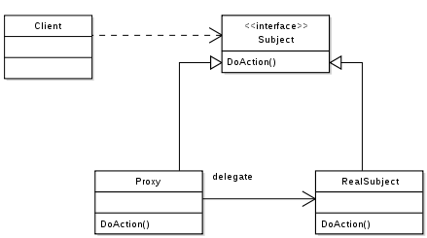

Slide 10
Client: This class represents the object that will interact with the subject. It doesn't know the real implementation details of the subject and relies solely on the Subject interface.
Subject: This is an abstract interface that defines the operations the proxy and real subject will implement. These operations allow the client to interact with the subject in a standard way.
RealSubject: This is the concrete class that implements the Subject interface. It represents the actual object that the proxy protects or controls access to. It can be heavyweight or complex.
Proxy: This class also implements the Subject interface. It acts as a surrogate for the RealSubject. It can have various functionalities like:
Lazy loading the real subject when an operation is first called.

Slide 11
04
Real Word Example

Slide 12

E-Book Access with the Proxy Pattern
Problem: Accessing large library e-books can be slow and requires authorization.
Solution: Proxy pattern for optimization and security.

Slide 13
Classes:
EBook (Interface):
getTitle(), getAuthor(), displayContent()
RealEBook:
Implements EBook, holds full e-book (simulated)
Loading is time-consuming.
EBookProxy:
Implements EBook, has title, author, preview
Checks student ID
Loads RealEBook on-demand (lazy loading)

Slide 14
How it Works
User interacts with EBookProxy.
Proxy shows instant preview.
If full content is needed:
Proxy checks authorization.
Loads RealEBook (if necessary).

